Slide 1



AZERBAIJAN
Country Profile

Slide 2
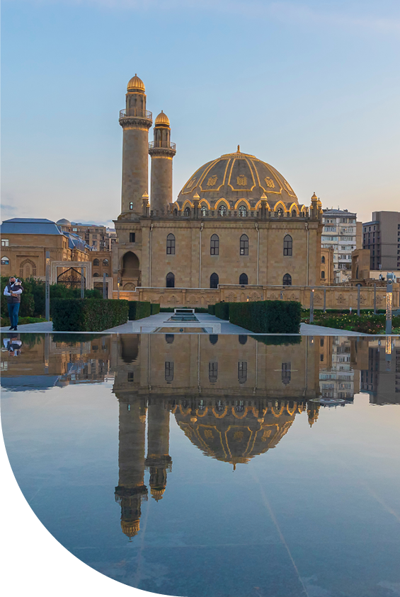

Azerbaijan Country Profile
Azerbaijan is a country located at the crossroads of Eastern Europe and Western Asia, bordered by the Caspian Sea to the east, and sharing land borders with Russia, Georgia, Armenia, and Iran. The official language of Azerbaijan is Azerbaijani (or Azeri), which belongs to the Turkic language family. The currency used is the Azerbaijani manat (AZN).
Azerbaijan has a diverse economy primarily driven by the oil and gas sector, which plays a crucial role in the country's revenue and economic development. The nation also has agricultural products, including cotton, tobacco, and fruits, contributing to its GDP.
Over recent years, Azerbaijan has made efforts to diversify its economy by investing in sectors such as tourism, information technology, and renewable energy. The country’s strategic location and rich natural resources make it a significant player in regional and global energy markets.

Slide 3

Income Tax Overview in Azerbaijan
1
Tax authority
The State Tax Service under the Ministry of Economy of the Republic of Azerbaijan overseas tax collection and control in Azerbaijan.
2
Tax calculation
Taxes are computed based on gross salary, including benefits in kind, with several exemptions and deductions applied before final calculation.
3
Exemptions and deductions
The categorical net taxable salary is determined by deducting from the gross amount the compulsory deductions made by the employer with a view to the creation of annuities, retirement pensions or to cover compulsory social security schemes and other allowed deductions by the regulation.
4
Tax year
The Azerbaijan tax year runs from January 1 to December 31, aligning with the calendar year for ease of reporting and compliance.

Slide 4

Income Tax Rates in Azerbaijan
The tax on the monthly income from salaried work of individuals who do not have activities in the oil and gas field and work for taxpayers belonging to the non-state sector is charged according to the following table for a period of 7 years from January 1, 2019.
Monthly Taxable Income | Tax Rate
Up to AZN 8000 | 0%
If it is more than 8000 AZN | 14% of the amount exceeding AZN 8,000
The following tax rates apply to an individual’s monthly taxable income earned from employment activities in the oil and gas and public sectors.
Monthly Taxable Income | Tax Rate
Up to AZN 2500 | 14%
If it is more than AZN 2500 | 350 AZN + 25% of the amount exceeding 2500 AZN
An income of AZN 200 is exempt from taxation, if the monthly income is below
AZN 2,500.

Slide 5

Tax - Deductions and Exemptions
The monthly taxable income from any salaried work of the following natural persons is reduced by AZN 400
Heroes of the National Patriotic War of the Republic of Azerbaijan
National Heroes of Azerbaijan
Heroes of the Soviet Union and Socialist Labor
Persons with disabilities related to war
Widows (husbands) and children of fallen or later deceased fighters (except for those who received the status of martyrs)
Persons awarded with orders and medals for selfless work on the rear front in 1941-1945
Persons who received the title of war veteran in accordance with the law
Radiation sickness and disease related to radiation load as a result of the accident at the Chernobyl NPP, other radiation accidents at civil or military nuclear facilities, as well as any types of nuclear facilities, including tests, exercises and other activities related to nuclear weapons and space technology those who have or have had these diseases.

Slide 6

Tax - Deductions and Exemptions
Due to 61-100 percent impairment of body functions defined (except for war-related disabled persons), disabled persons under the age of 18, disabled persons under the age of 18 who require constant care, or parents who care for and live with a person with a disability determined due to 81-100 percent impairment of body functions, The taxable monthly income of one (including adoptive persons), wife (husband), guardian or guardian from any salaried work is reduced by AZN 200.
The monthly taxable income from any salaried work of the following natural persons is reduced by AZN 100
Parents of fighters who died or later died (except for those who received the status of martyrs) , as well as parents and wives (husbands) of civil servants who died during the performance of their duties. Relief is granted to the wives (husbands) of these persons if they have not remarried
Military personnel sent to Afghanistan and other countries where hostilities are taking place and military officials called to training camps
IDPs and persons treated as equals. This benefit does not apply to persons who are permanently settled as a result of acquiring a separate housing area under housing legislation or civil legal agreements.

Slide 7

Tax - Deductions and Exemptions
Regardless of the degree of kinship, the taxable monthly income of a husband or wife with at least three dependents, including full-time pupils and students under the age of 23, is reduced by AZN 50
This rule is maintained until the end of the year when children reach the age of 18, students and pupils reach the age of 23, as well as until the end of the year of death in the case of the death of children and dependents.
The taxable income of natural persons is reduced starting from the month of the child's birth and the dependent's adoption.
If the number of dependents decreases during the year (except for cases of death of children), deduction of the amount for their maintenance is terminated starting from the month following the month in which the number of dependents decreases.

Slide 8

Income Tax Compliance in Azerbaijan
Monthly Employer Filing
Employers must submit monthly tax returns for their employees by the 20th of
the following month after the end of each Quarter, ensuring timely reporting of
tax liabilities.
Annual Employer Filing
Annual tax return is not applicable.
Employee Annual Filing
Residents having taxable income that was not taxed at source or deriving income outside of Azerbaijan and Non-residents having taxable income not taxed in Azerbaijan through the withholding mechanism, must submit the annual Income tax return to the tax authorities by 31 March of the following year.
Filing Method and Payment
Filings are made via the e-taxes online portal, and tax payments can be made electronically or at ExpressPay terminals.

Slide 9

Social Security System in Azerbaijan
Social insurance contribution rates for individuals engaged in employment activities
in non-oil and gas and nonpublic sectors is as below, effective from 1 January 2019,
for a period of seven years.
Amount of income | Social contribution per employee | Social contribution per employer
Up to AZN 200 | 3% | 22%
Above AZN 200 | AZN 6 + 10% for the amount above AZN 200 | AZN 44 + 15% for the amount above AZN 200
Employers in the oil and gas and public sectors are required to contribute 22% of
their employees' gross salaries to the Social Protection Fund as social insurance.
Additionally, a 3% deduction is made from each employee's salary, which is also remitted to the Social Protection Fund.

Slide 10

Social Security Compliance in Azerbaijan
Monthly Submissions
Social Security contributions are due by the 15th of the following month, and filings must be completed within 20 days after the end of each calendar quarter. This regular reporting ensures continuous coverage and timely fund allocation.
Online Portal
The SPF online portal facilitates declarations and payments, streamlining the process for employers and reducing administrative burden. This digital approach aligns with modern governance practices.
Penalties for Non-Compliance
Late payment of the monthly contributions will attract penalties.

Slide 11
Unemployment Insurance Contributions (UIC)
Employers are required to contribute to unemployment insurance for individuals employed under local agreements. For these employees, employers must pay a contribution rate of 0.5% of the employees' gross salary. Additionally, they must withhold another 0.5% from the employees' salaries. The total contribution of 1% of the gross salary is then submitted to the Unemployment Fund.
Compulsory medical insurance
According to the legislation, individuals who work for a salary, military personnel (except for military personnel of temporary active military service), persons appointed to a position by the Milli Majlis of the Republic of Azerbaijan or the body (institution) determined by the relevant executive authority, and persons holding elective paid positions must contribute to the compulsory health insurance.The calculation and payment of mandatory medical insurance is as follows:
Amount of income | Social contribution per employee | Social contribution per employer
Up to AZN 8000 | 2% | 2%
Above AZN 8000 | AZN 160 + 0.5% for the amount above AZN 8000 | AZN 160 + 0.5% for the amount above AZN 8000

Slide 12




Labor Law Fundamentals in Azerbaijan
Minimum
Wage
The minimum monthly wage in Azerbaijan is AZN 345
Contract
Types
Fixed contact
Unlimited contract
Part-Time contract
Working
Hours
The regular number of
hours per working week in Azerbaijan is 40, although
this can be reduced for
some groups.
Probation
Period
Probationary periods can be stated in employment contracts and cannot exceed a period of 3 months.

Slide 13
Overtime Regulations in Azerbaijan
Overtime work refers to any hours worked that exceed the standard working hours specified in the employment contract or internal work policies. Each employee cannot be involved in overtime work for more than four hours during two consecutive working days, and more than two hours in workplaces with harsh and harmful working conditions. The employer must create industrial and social-living conditions in accordance with the norms stipulated in the "Labor protection" section of the Code and ensure labor safety for employees involved in overtime work.
Employees are paid wages for each hour of overtime work as follows:
1. For hourly remuneration system – The amount of not less than twice the hourly tariff rate (salary) (200% of the normal hourly wage rate).
For piece-rate remuneration system – the amount of piecework wages and additional payments not less than hourly wage rate (salary) of the corresponding time-worker category (qualification).
2. In the labor contract, in the collective agreement, it may be provided for the payment of a higher amount of additional fee to the employees for the work done during the working time.
3. Replacement of overtime work with an additional day off is not allowed.

Slide 14
Leave Policies and Employment Termination
in Azerbaijan
Annual Leave: The minimum amount of annual paid leave is 21 calendar days, although some special categories of employees are entitled to a minimum of 30 calendar days per year. Additionally, the entitlement can increase based on factors such as years of service with a company and other conditions.
Maternity Leave: Women who work during pregnancy and for the postpartum period are granted paid leave for a period of 126 calendar days (70 calendar days before childbirth and 56 calendar days after childbirth). If childbirth is difficult, if two or more children are born, the postpartum leave is granted for a period of 70 calendar days.
Sick Leave: Employees are entitled to paid sick leave, provided they submit medical documentation. The employer covers the pay for the first 14 days of the sick leave, while any additional days are compensated by the State Social Protection Fund.
Employment Termination: Contracts of unspecified duration can be terminated with notice, while specified duration contracts may end due to expiry, force majeure, gross misconduct, or mutual consent.

Slide 15
Employer of Record Services
(EOR)
Office 2401
API Trio Tower
Al Barsha 1
Dubai, UAE
+971 4 295 8770
info@transskills.com | transskills.com

